Slide 1



Tania Hasanpoor, Hong Xin, Daniel Dash, Temi Lajumoke, Melissa Ellin, Lily Kepner, Duo (Miranda) Xu

Slide 2


Technical Team

Slide 3
After First Meeting with Advisors

Slide 4
Topic Modeling
Goals:
Generate word embeddings using Boston Globe articles from 2014-2018, using Word2Vec and Doc2Vec
Find the top words used in the most similar contexts as those in a list of provided keywords
Analyze any potentially interesting trends

Slide 5
Topic Modeling
Progress:
We generated the top five words used in similar contexts to the given keywords.
We analyzed the results for any potentially interesting findings.
We also trained Word2Vec on bigrams (as opposed to single words) using the Gensim Phrases package.
Finally, we plotted word clouds for both types of analyses.

Slide 6
Topic Modeling
Results:
We noticed some interesting findings in the unigram analysis using Word2Vec: some negative words such as ‘unaccountable’, ‘bullying’, ‘disputing’, ‘deray’, ‘devolved’, etc. were computed to be among the most similar to ‘black’ and black ethnic groups.
The bigram analysis using Word2Vec computed other races and ethnicities to be the most similar to ‘black’ and black ethnic groups.
The Doc2Vec analysis did not result in particularly interesting findings, likely because Word2Vec works on a more granular level.
We plotted word clouds too, but those were not very readable (example on next slide).

Slide 7
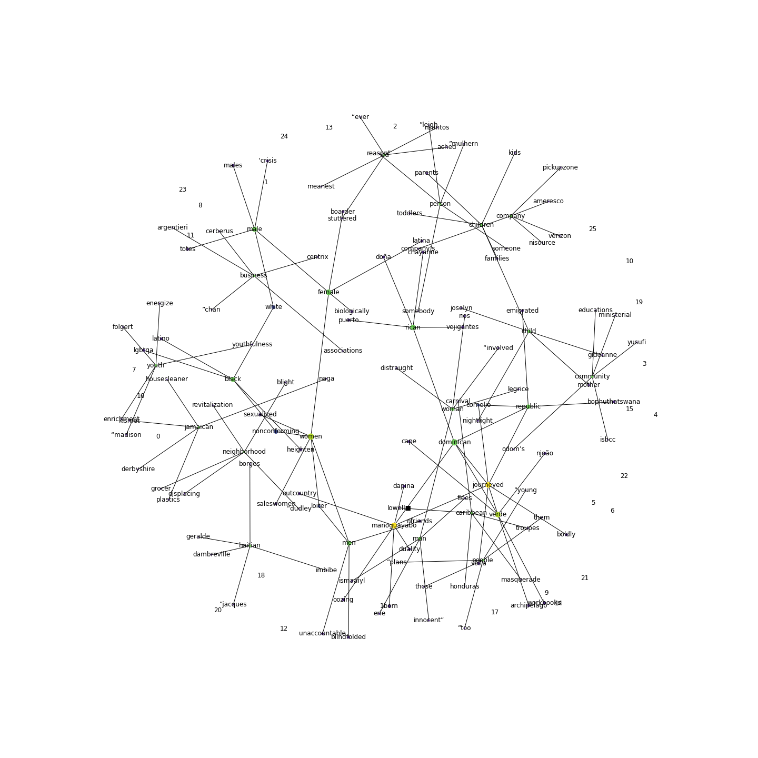

Slide 8
Sentiment Analysis
Goals:
Use spaCy to process Boston Globe articles from 2014 – 2018 and perform named entity recognition (NER) on the processed ‘documents’
Identify all the entities labelled ‘PERSON’ or ‘ORG’
Use ethnicolr to predict the races of all identified people, using their last names, from U.S. Census data
Identify and extract all quotes in the articles, along with their respective authors

Slide 9
Sentiment Analysis
Progress:
We were able to use spaCy with its medium English language model (one of several language models available for use with spaCy) to process the articles.
spaCy’s included pipelines performed named entity recognition on the data, and we were able to simply extract all the entities labelled as people or organizations.
Finally, we were able to extract the last names of entities identified as people, and feed those ethnicolr to predict their races.
We were able to extract quotes from each of the articles, by looking through the text.

Slide 10
Sentiment Analysis
Results:
We obtained four different datasets for each year:
A dataset of all entities labelled as people or organizations
A dataset of the names of all people mentioned in the articles
A dataset of the last names of all identified people and their predicted races
A dataset of all the quotes used in all the articles

Slide 11
After Second Meeting with Advisors

Slide 12
Topic Modeling
Goals:
Repeat last week’s process, but with black-majority and white-majority neighborhood names as keywords, instead of the ones provided earlier (this was picked up from Fall 2020’s project report; picture on next slide)
For each set of similar words for a given keyword, use the generated word embeddings to compute a ‘mean’ representative word which captures the meaning, to some extent, of the corresponding similar words
Keep track of keyword frequency
Analyze any potentially interesting trends

Slide 13
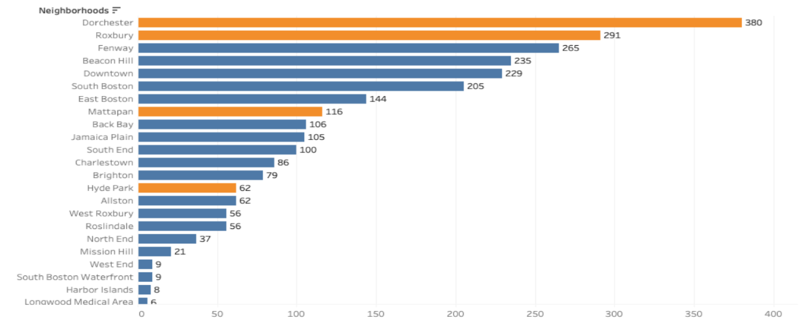

Slide 14
Topic Modeling
Progress:
We generated the top five words used in similar contexts to the given neighborhoods; however, this resulted in other neighborhood names being computed as the most similar, so we filtered those out.
We used the word embeddings and the neighborhood-filtered similar words to compute an average representative word for each neighborhood.
We analyzed the results for any potentially interesting findings.
Finally, we plotted word clouds for both types of analyses.

Slide 15
Topic Modeling
Results:
This time, the most similar words do not seem to be of much interest.
The representative vectors for each neighborhood ended up being either the same neighborhood or another neighborhood (seems intuitive).
However, it was interesting to note that in the few cases where neighborhoods were not represented by themselves, the black-majority neighborhoods were represented by other black-majority neighborhoods, and white-majority ones mostly by other white-majority ones (example on next slide).
This points toward some difference; whether this difference is in addition to cultural and political differences between the two communities is yet to be analyzed.

Slide 16
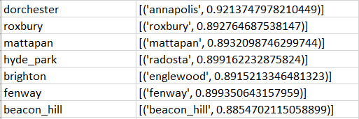

Slide 17
Topic Modeling
Next steps:
Extract vectors for each majority-neighborhood and black, and white ethnic groups from the word embeddings
Use the mean vectors from all possible neighborhood-ethnicity combination to look for the most similar words to both
Analyze differences between results from the steps above and last week

Slide 18
Sentiment Analysis
Goals:
Analyze Boston Globe 2014 – 2018 articles and figure out which articles refer to which neighborhoods
Compute the distribution of black-majority and white-majority neighborhoods in terms of media coverage
Continue working on quote extraction to identify authors for the quotes

Slide 19
Sentiment Analysis
Progress:
We went through each of the articles and tracked occurrences of neighborhood names from our keywords from word embeddings.
Separately, we tracked the number of times a neighborhood name occurred in each of the articles, and tagged the article as discussing the neighborhood that occurred most frequently.
We are currently working on determining the authors for all the extracted quotes and generating the corresponding dataset.

Slide 20
Sentiment Analysis
Results:
Black-majority neighborhoods were found to be a lot more highly covered in the media, compared to white-majority neighborhoods.
We now have a dataset for each year, containing each of the articles for each of the given neighborhoods for that year.

Slide 21

Journalism and UX

Slide 22
Journalism Goals for Summer
- Complete Frame Analysis
- Work with Brooke Williams and Michelle Johnson to develop a codebook for explicit and implicit mentions of race
- Annotate LexisNexis articles for explicit mentions of race
- Annotate for implicit mentions of race using the codebook
- Interviews
- Develop script and sample questions
- Compile list of interview subjects
- Conduct interviews with editors and journalists to determine how they would like to use a product

Slide 23
What’s been done so far?
- Drafted a script for interviews
- Searched for tools like that of our end product
- Received LexisNexis training
- Scraped for Boston Globe articles
- Practiced Frame Analysis readings using 140 articles spanning 2014-2020

Slide 24
Next Steps
- Finalize interview script (meeting July 6)
- Develop codebook with Brooke (July 6)
- Finalize interview subject list and schedule interviews
- Retrieve LexisNexis articles
- Begin annotations
- Continue frame analysis

Slide 25
UX Goal for the Summer
- Finalize the User interview script
- Conduct user interviews to found out users’ needs
- Start working on the Lo-fi wireframes of the dashboard / website to track racial bias in the media and the real-time editors tool (similar to grammarly)

Slide 26
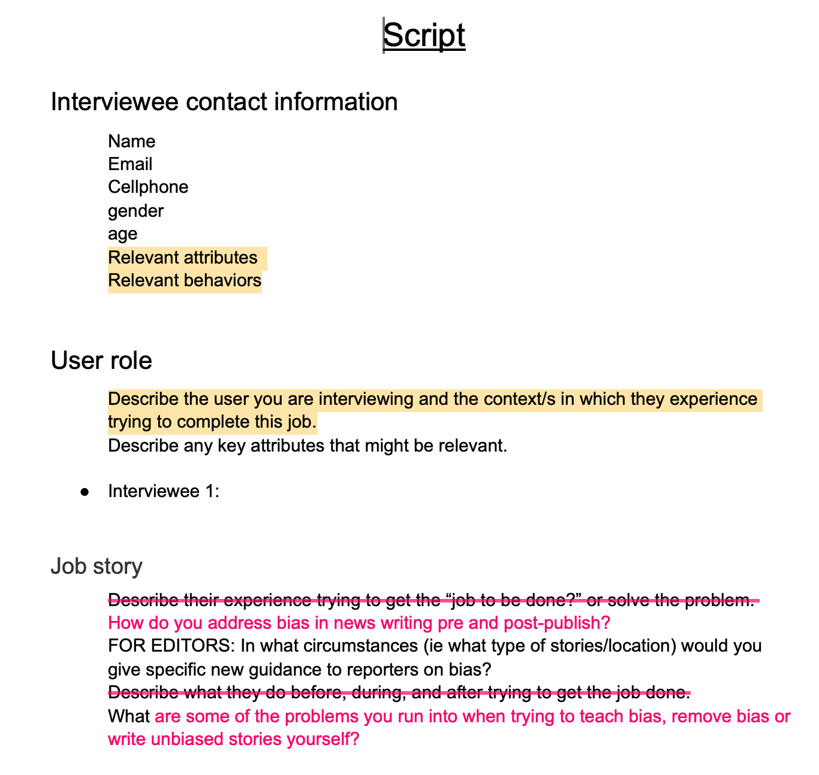
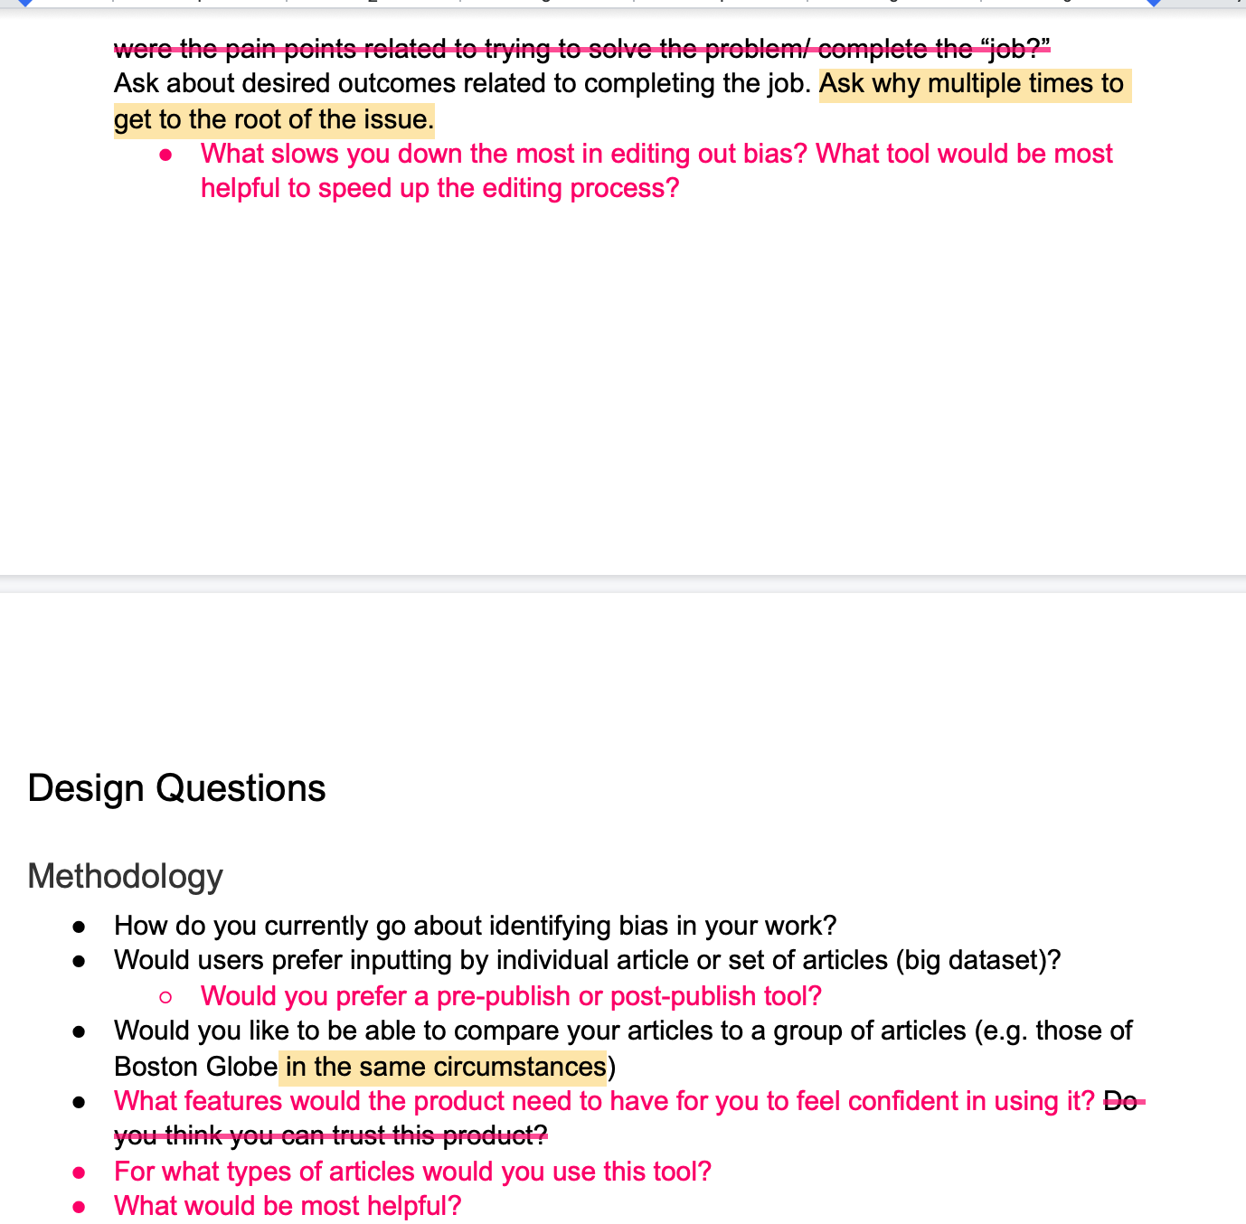
UX Progress——Interview Script

Slide 27
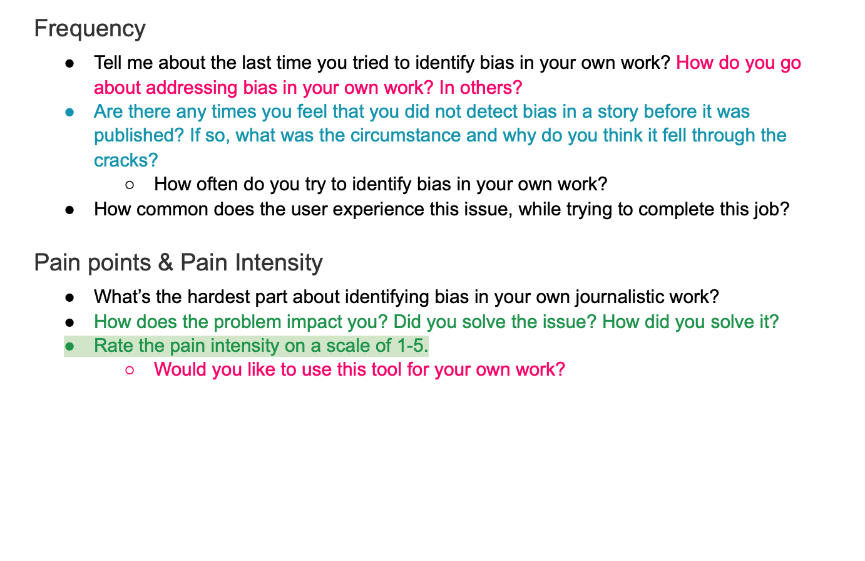
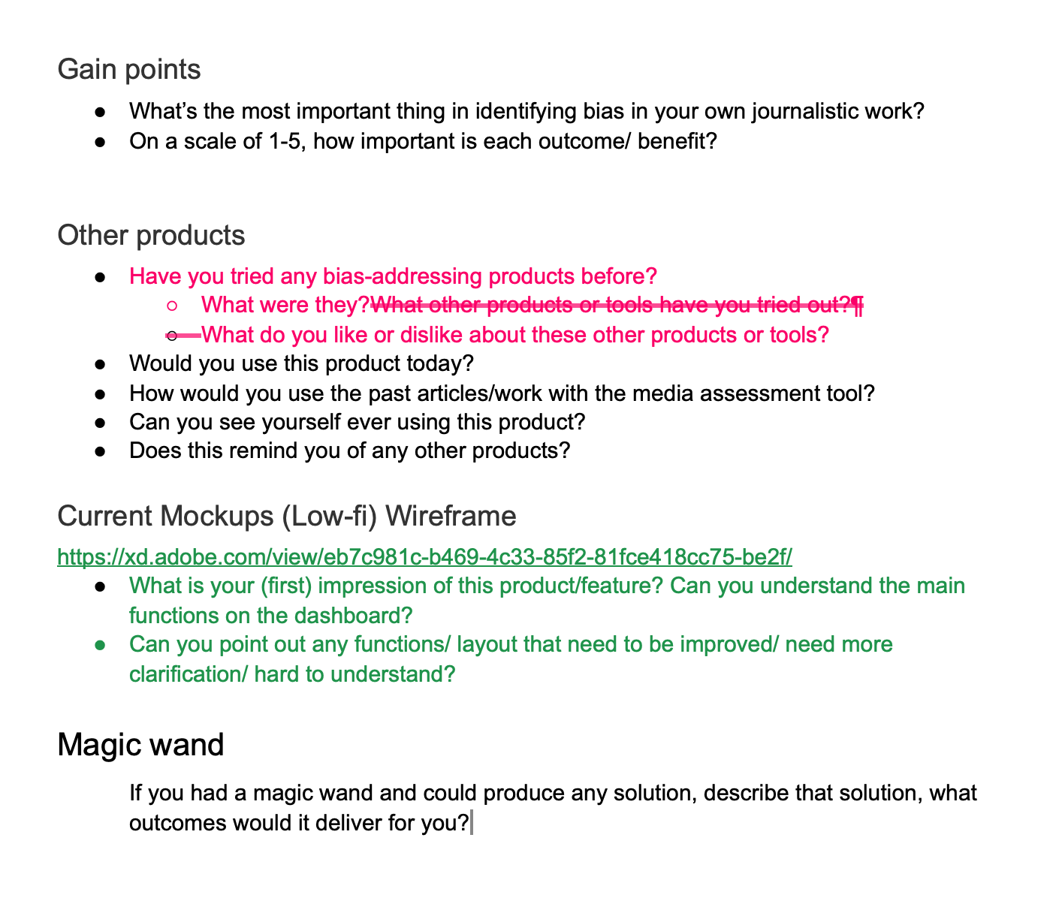
UX Progress——Interview Script

Slide 28
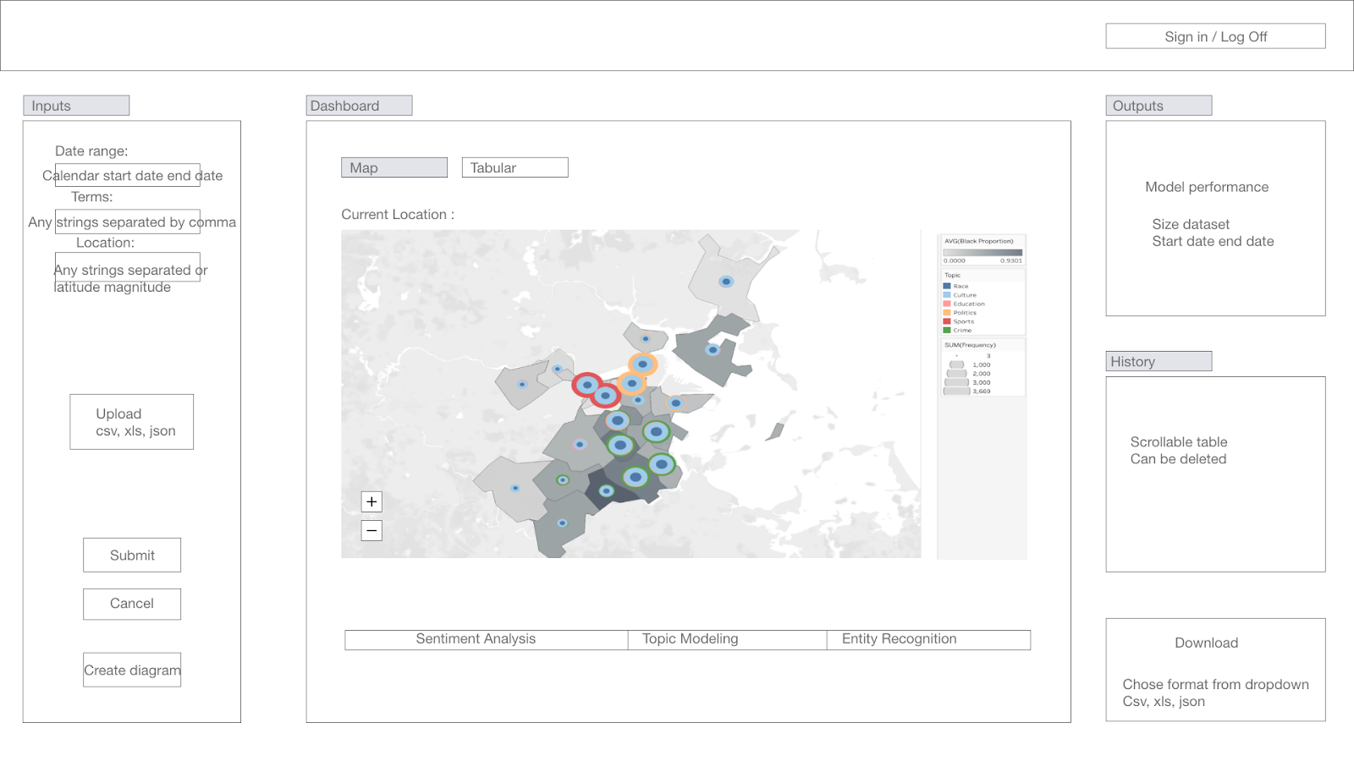
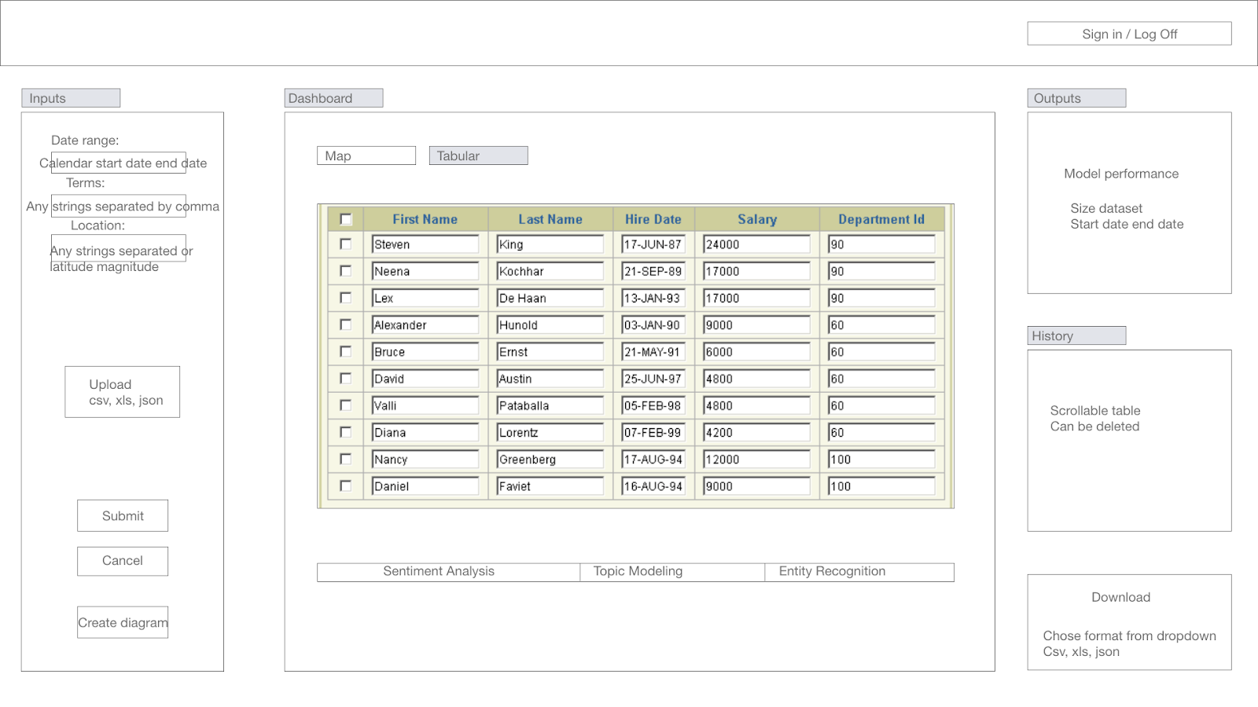
UX Progress——Lo-fi Wireframes for
Dashboard

Slide 29
UX Next Step
- Finalize the User interview script
- Design a basic layout (lo-fi frame) of the real-time editors tool for interview use
- Conduct user interview
- Research and Create a moodboard of the ux
- May start working on the wireframe after user interview (depend on time)

